Slide 1

DEPARTMENT OF COMPUTER SCIENCE

Slide 2
ACTIVITY
Objectives: At the end of completing this activity students are able to understand
4. What is computer programming
4.2 Reasons to study programming
4.3 Types and usage of computer languages
4.4 Programming paradigms
Procedural programming
Functional programming
Object-oriented Programming
4.5 Algorithm representation and Data structure
Introduction to flow chart and pseudo code
How to write a pseudo code and draw a flow chart for a given algorithm
Translating algorithms to programming languages
Definition of data structures
Role of data structures in writing programs
Algorithms Vs Data Structure

Slide 3
Define the terms program, computer programming and programming languages?
List down some of the reasons that a computer science professionals needs to study computer programming?
The instruction is in binary form, which can be directly understood by the computer (CPU) without translating them, is called is_________________
It is a low-level programming language, also known as second generation of programming language and writes instructions using symbolic (mnemonics) instruction code is_______________________
The CPU only understands machine language, so a special program known as an____________________is used to translate an assembly language program to a machine language program
Bothe Machine and assembly languages are machine dependent programming languages, explain what is machine dependent?
_____________is a programming languages that are close to human languages (like English languages or mathematical notations).

Slide 4
8. ______________ is a program that translates a high-level language program into a separate machine language program
9. A CPU understands instructions that are written only in what language?
10. A program has to be copied into what type of memory each time the CPU executes it?
11. When a CPU executes the instructions in a program, it is engaged in what process?
12. What type of programming language allows you to create powerful and complex programs without knowing how the CPU works?
13. Each language has a set of rules that must be strictly followed when writing a program. What is this set of rules called?
14. What do you call a program that translates a high-level language program into a separate machine language program?
15. What do you call a program that both translates and executes the instructions in a high-level language program?
16. What type of mistake is usually caused by a misspelled key word, a missing punctuation character, or the incorrect use of an operator?

Slide 5
17. _____________ are different ways or styles in which a given program or programming language can be organized
18. Which programming paradigm consists of set of procedures which is referred as function, method or subroutines?
19. FORTRAN, COBOL, C, C++, Ruby, PHP, JavaScript, Python, Pascal, ColdFusio are examples of ________________programming paradigm
20. Functional programming attempts to solve the problem by composing mathematical functions as a program components. List down examples of this programming paradigm?
21. In Object-oriented Programming all real-world entities are represented by ______________
22. ______________is an object-oriented programming concept that refers to the ability of a variable, function or object to take on multiple forms
23. _____________is an OOP concepts that is a mechanism where you can derive a class from another class for a hierarchy of classes that share a set of attributes and methods

Slide 6
24. Programming errors are named as________________and the process of checking and correcting errors are called________________
25. Program development is the process of writing or creating or developing application programs. This is called Program Development Life Cycle (PDLC). List down and explain PDLC?
26. ___________is the programming tools to represent the problem or the task graphically
27. ___________ is a method of describing computer algorithms using a combination of natural language and programming language
28. ________ is the process of translation of the algorithm into programming language
29. __________ is a step-by-step procedure, which defines a set of instructions to be executed in a certain order to get the desired output
30. _____________is a format that organizes, manages, and stores data

Slide 7
Activity on Algorithms and Flowchart
Direction:
Read the algorithm and the flow chart that is provided for question 1-18 (slide 8-25) and translate these algorithms into C++ code.
For the remaining questions (19-24) provided on slide 26:
Analyse the problem
Write the algorithm for the problem,
Draw a flowchart
Write C++ code, debug and test using Red Panda C++ language

Slide 8
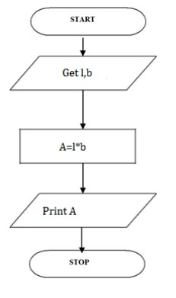
1. The following is an algorithm and a flowchart to find area of a rectangle
Step 1: Start
Step 2: get l,b values
Step 3: Calculate A=l*b
Step 4: Display A
Step 5: Stop
BEGIN
READ l,b
CALCULATE A=l*b
DISPLAY A
END

Slide 9
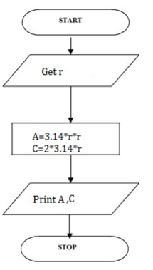
2. Write an algorithm for Calculating area and circumference of circle
Step 1: Start
Step 2: get r value
Step 3: Calculate A=3.14*r*r
Step 4: Calculate C=2.3.14*r
Step 5: Display A,C
Step 6: Stop
BEGIN
READ r
CALCULATE A and C
A=3.14*r*r
C=2*3.14*r
DISPLAY A
END

Slide 10
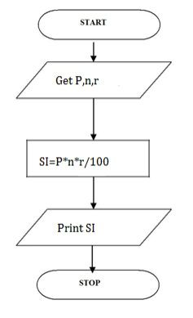
3. Write an algorithm for Calculating simple interest
Step 1: Start
Step 2: get P, n, r value
Step3:Calculate
SI=(p*n*r)/100
Step 4: Display S
Step 5: Stop
BEGIN
READ P, n, r
CALCULATE S
SI=(p*n*r)/100
DISPLAY SI
END

Slide 11
4. Write an algorithm for Calculating area and circumference of circle
Step 1: Start
Step 2: get r value
Step 3: Calculate A=3.14*r*r
Step 4: Calculate C=2.3.14*r
Step 5: Display A,C
Step 6: Stop
BEGIN
READ r
CALCULATE A and C
A=3.14*r*r
C=2*3.14*r
DISPLAY A
END

Slide 12
5. Write an algorithm for Calculating simple interest
Step 1: Start
Step 2: get P, n, r value
Step3:Calculate
SI=(p*n*r)/100
Step 4: Display S
Step 5: Stop
BEGIN
READ P, n, r
CALCULATE S
SI=(p*n*r)/100
DISPLAY SI
END

Slide 13
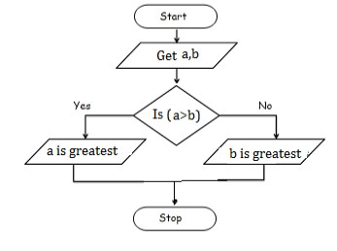
6. To check greatest of two numbers
Step 1: Start
Step 2: get a,b value
Step 3: check if(a>b) print a is greater
Step 4: else b is greater
Step 5: Stop
BEGIN
READ a,b
IF (a>b) THEN
DISPLAY a is greater
ELSE
DISPLAY b is greater
END IF
END

Slide 14
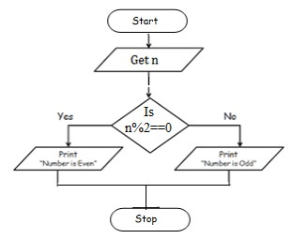
7. To check leap year or not
Step 1: Start
Step 2: get y
Step 3: if(y%4==0) print leap year
Step 4: else print not leap year
Step 5: Stop
BEGIN
READ y
IF (y%4==0) THEN
DISPLAY leap year
ELSE
DISPLAY not leap year
END IF
END

Slide 15
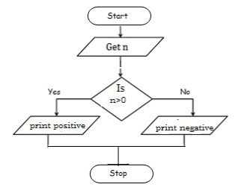
8. To check positive or negative number
Step 1: Start
Step 2: get num
Step 3: check if(num>0) print a is positive
Step 4: else num is negative
Step 5: Stop
BEGIN
READ num
IF (num>0) THEN
DISPLAY num is positive
ELSE
DISPLAY num is negative
END IF
END

Slide 16
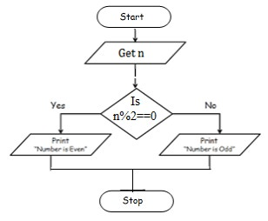
9. To check odd or even number
Step 1: Start
Step 2: get num
Step 3: check if(num%2==0)
Step 4: Print num is even
Step 5: else num is odd
Step 6: Stop
BEGIN
READ num
IF (num%2==0) THEN
DISPLAY num is even
ELSE
DISPLAY num is odd
END IF
END

Slide 17
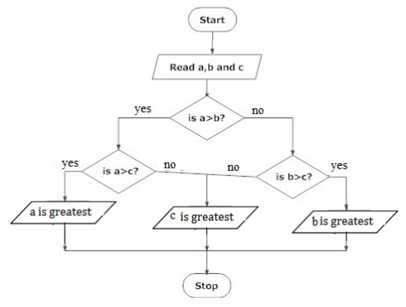
10. To check greatest of three numbers
Step1: Start
Step2: Get A, B, C
Step3: if(A>B) goto Step4 else goto step5
Step4: If(A>C) print A else print C
Step5: If(B>C) print B else print C
Step6: Stop
BEGIN
READ a, b, c
IF (a>b) THEN
IF(a>c) THEN
DISPLAY a is greater
ELSE
DISPLAY c is greater
END IF
ELSE
if (b>c) THEN
DISPLAY b is greater
ELSE
DISPLAY c is greater
END IF
END IF
END

Slide 18
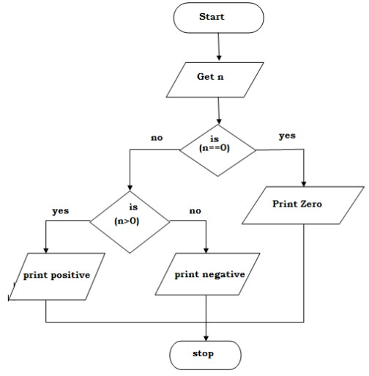
11. Write an algorithm to check whether given number is +ve, -ve or zero.
Step 1: Start
Step 2: Get n value.
Step 3: if (n ==0) print “Given number is Zero” Else goto step4
Step 4: if (n > 0) then Print “Given number is +ve”
Step 5: else Print “Given number is -ve”
Step 6: Stop
BEGIN
GET n
IF(n==0) THEN
DISPLAY “ n is zero”
ELSE
IF(n>0) THEN
DISPLAY “n is positive”
ELSE
DISPLAY “n is positive”
END IF
END IF
END

Slide 19
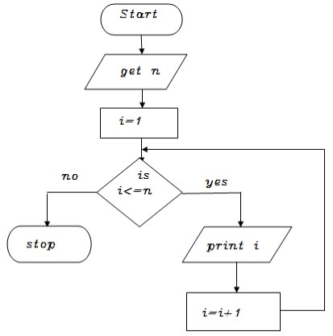
12. Write an algorithm to print all natural numbers up to n
Step 1: Start
Step 2: get n value.
Step 3: initialize i=1
Step 4: if (i<=n) go to step 5 else go to step 8
Step 5: Print i value
step 6 : increment i value by 1
Step 7: go to step 4
Step 8: Stop
BEGIN
GET n
INITIALIZE i=1
WHILE(i<=n) DO
PRINT i
i=i+1
ENDWHILE
END

Slide 20
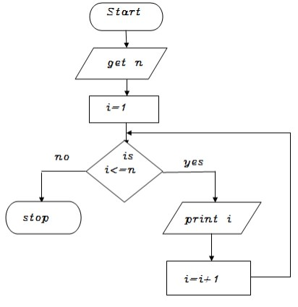
13. Write an algorithm to print n odd numbers
Step 1: start
step 2: get n value
step 3: set initial value i=1
step 4: check if(i<=n) goto step 5 else goto step 8
step 5: print i value
step 6: increment i value by 2
step 7: goto step 4
step 8: stop
BEGIN
GET n
INITIALIZE i=1
WHILE(i<=n) DO
PRINT i
i=i+2
ENDWHILE
END

Slide 21
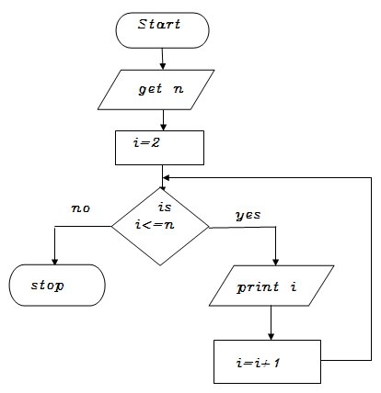
14. Write an algorithm to print n even numbers
Step 1: start
step 2: get n value
step 3: set initial value i=2
step 4: check if(i<=n) goto step 5 else goto step8
step 5: print i value
step 6: increment i value by 2
step 7: goto step 4
step 8: stop
BEGIN
GET n
INITIALIZE i=2
WHILE(i<=n) DO
PRINT i
i=i+2
ENDWHILE
END

Slide 22
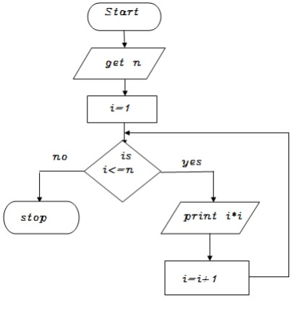
15. Write an algorithm to print squares of a number
Step 1: start
step 2: get n value
step 3: set initial value i=1
step 4: check i value if(i<=n) goto step 5 else goto step8
step 5: print i*i value
step 6: increment i value by 1
step 7: goto step 4
step 8: stop
BEGIN
GET n
INITIALIZE i=1
WHILE(i<=n) DO
PRINT i*i
i=i+2
ENDWHILE
END

Slide 23
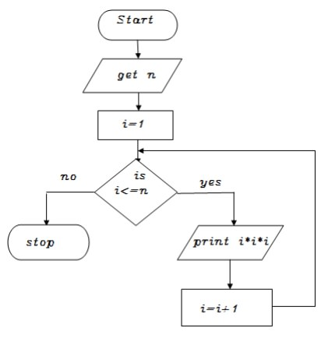
16. Write an algorithm to print cubes of a number
Step 1: start
step 2: get n value
step 3: set initial value i=1
step 4: check i value if(i<=n) goto step 5 else goto step8
step 5: print i*i *i value
step 6: increment i value by 1
step 7: goto step 4
step 8: stop
BEGIN
GET n
INITIALIZE i=1
WHILE(i<=n) DO
PRINT i*i*i
i=i+2
ENDWHILE
END

Slide 24
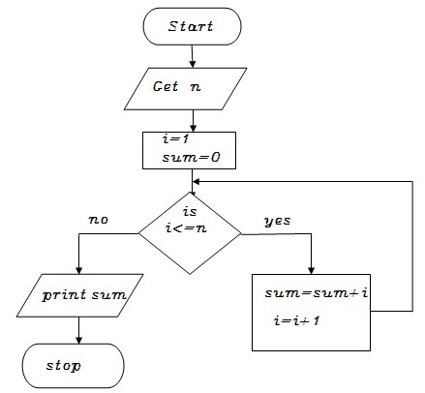
17. Write an algorithm to find sum of a given number
Step 1: start
step 2: get n value
step 3: set initial value i=1, sum=0
Step 4: check i value if(i<=n) goto step 5 else goto step8
step 5: calculate sum=sum+i
step 6: increment i value by 1
step 7: goto step 4
step 8: print sum value
step 9: stop
BEGIN
GET n
INITIALIZE i=1,sum=0
WHILE(i<=n) DO
sum=sum+i
i=i+1
ENDWHILE
PRINT sum
END

Slide 25
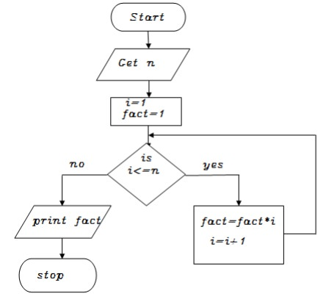
18. Write an algorithm to find factorial of a given number
Step 1: start
step 2: get n value
step 3: set initial value i=1, fact=1
Step 4: check i value if(i<=n) goto step 5 else goto step8
step 5: calculate fact=fact*i
step 6: increment i value by 1
step 7: goto step 4
step 8: print fact value
step 9: stop
BEGIN
GET n
INITIALIZE i=1,fact=1
WHILE(i<=n) DO
fact=fact*i
i=i+1
ENDWHILE
PRINT fact
END

Slide 26
19. Analyse the problem, write algorithm, and draw a flowchart for the problem for logging onto Gmail account and checking your mails
20. Problem: Add 10 and 20. Analyse the problem, write the algorithm, draw a flowchart and write C++ code for this problem
21. Print Hello World 10 times. This problem is also solved using the loop concept. We take a variable count and set it to zero. Then we print "Hello World" and increment count by 1. Analyse the problem, write the algorithm, draw a flowchart and write C++ code
22. Draw a flowchart and write the algorithm to log in to Facebook account
23. Write algorithm and draw a flowchart to create Gmail account
24. Draw a flowchart and write the algorithm to login and use your personal computer (PC)

Slide 27
THE END!
THANKS

